Slide 1
Signals & Systems

Slide 2
Overview
Z Transform
Properties of z-transform
Transfer Function
Transfer Function & Difference Equation
Transfer Function & Impulse Response
Inverse Z Transform
Transfer Function & System Stability
Difference Equation & System Stability
Impulse & Step Responses
Steady State Output

Slide 3
Z Transform
The z transform is an important digital signal processing tool for describing and analyzing digital systems.
It also supports the techniques for digital filter design and frequency analysis of digital signals.
It takes a signal from the time domain to a frequency domain called the z domain.

Slide 4

Z Transform
The z transform for a digital signal x[n] is defined as
$$X\left(z\right)=Z\left\{x[n]\right\}$$
$$X\left(z\right)=\sum_{n=−∞}^{∞}{x\left[n\right]z^{−n}}$$
where z is the complex variable.

Slide 5

Z Transform
The z transform for causal signals is
$$X\left(z\right)=\sum_{n=0}^{∞}{x\left[n\right]z^{−n}}$$
It is referred to as a one-sided z-transform or a unilateral transform.

Slide 6
Z Transform Table
# | Signal x[n] | Z Transform X(z) | Region of Convergence
1 | δ[n] | 1 | All z
2 | u[n] | Z/(Z-1) | ⏐Z⏐> 1
3 | β^{n}u[n] | Z/(Z-β) | ⏐Z⏐> ⏐β⏐
4 | nu[n] | Z/(Z-1)² | ⏐Z⏐> 1
5 | nβ^{n} u[n] | βZ⁻¹/(1-βZ⁻¹)² | ⏐Z⏐> ⏐β⏐
6 | Cos(nΩ)u[n] | ZsinΩ/(Z² - 2zcosΩ + β) | ⏐Z⏐> 1

Slide 7
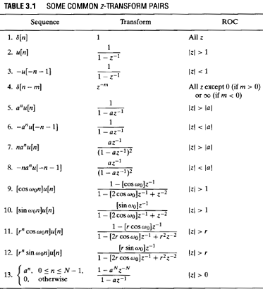
Z Transform Table

Slide 8
Region of Convergence (ROC)
The z transform for every signal has an associated Region of Convergence (ROC), the region of the z domain for which the transform exists.
Since the z-transform is an infinite series, it exists only for those values of z for which this series converges.
All the values of z that make the summation exist form a Region of Convergence (ROC) in the z-transform domain.
While all other values of z outside the ROC will cause the summation to diverge.

Slide 9
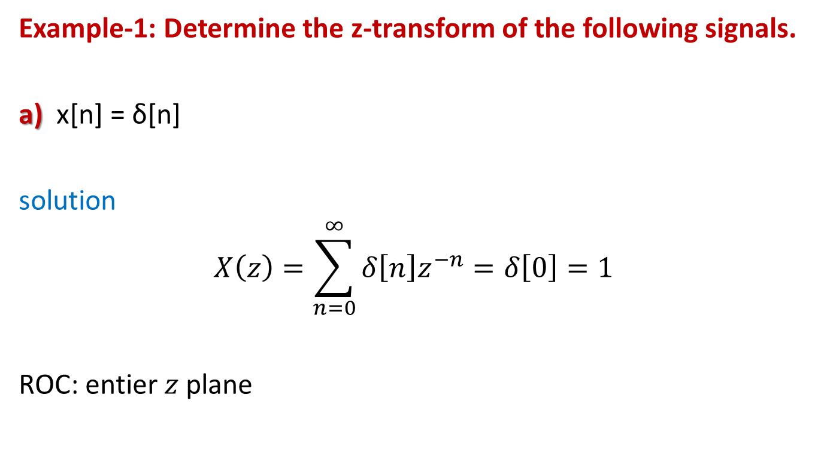
Z Transform
Example-1: Determine the z-transform of the following signals.
a) x[n] = δ[n]
solution
$$X\left(z\right)=\sum_{n=0}^{∞}{δ\left[n\right]z^{−n}}=δ\left[0\right]=1$$
ROC: entier 𝑧 plane

Slide 10
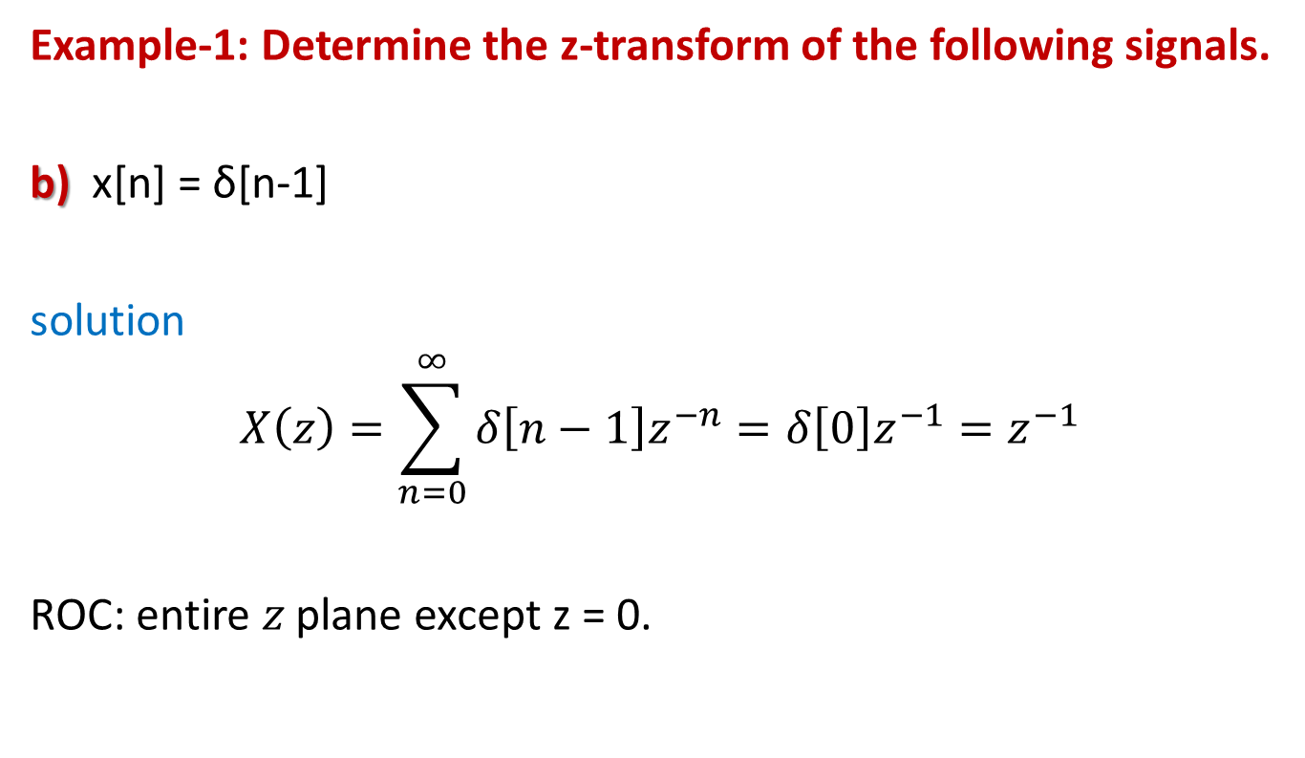
Z Transform
Example-1: Determine the z-transform of the following signals.
b) x[n] = δ[n-1]
solution
$$X\left(z\right)=\sum_{n=0}^{∞}{δ\left[n−1\right]z^{−n}}=δ\left[0\right]z^{−1}=z^{−1}$$
ROC: entire 𝑧 plane except z = 0.

Slide 11
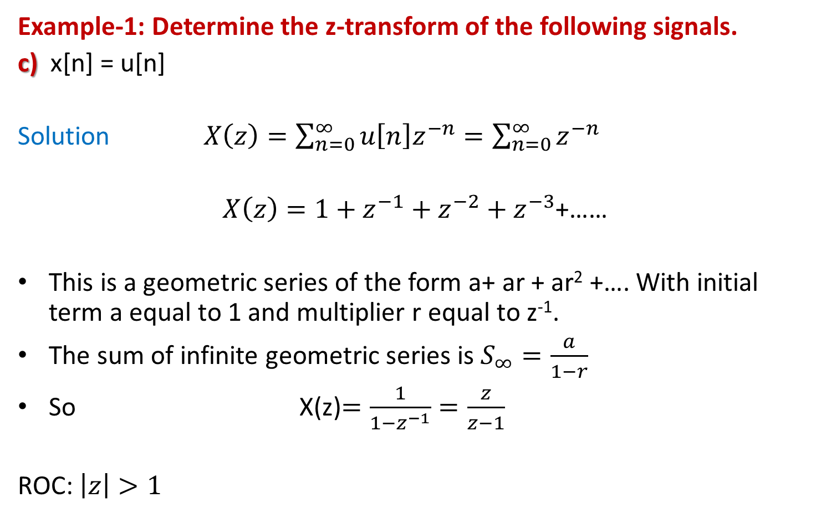
Z Transform
Example-1: Determine the z-transform of the following signals.
c) x[n] = u[n]
Solution $X\left(z\right)=\sum_{n=0}^{∞}{u\left[n\right]z^{−n}}=\sum_{n=0}^{∞}{z^{−n}}$
$X\left(z\right)=1+z^{−1}+z^{−2}+z^{−3}$+……
This is a geometric series of the form a+ ar + ar² +…. With initial term a equal to 1 and multiplier r equal to z⁻¹.
The sum of infinite geometric series is $S_{∞}=\frac{a}{1−r}$
So X(z)$=\frac{1}{1−z^{−1}}=\frac{z}{z−1}$
ROC: $\left|z\right|>1$

Slide 12

Z Transform
Example-1: Determine the z-transform of the following signals.
d) x[n] = u[n-1]
Solution
$X\left(z\right)=z^{−1}\frac{1}{1−z^{−1}}=z^{−1}\frac{z}{z−1}=\frac{1}{z−1}$
ROC: $\left|z\right|>1$

Slide 13
Z Transform
Example-1: Determine the z-transform of the following signals.
e)
Solution
x[n] = δ[n] + 2δ[n-1] + 5δ[n-2] + 7δ[n-3] + δ[n-5]
ROC: entire 𝑧 plane except 𝑧 = 0 and z =

Slide 14
Z Transform
Example-1: Determine the z-transform of the following signals.
f)
Solution
x[n] = δ[n+2] + 2δ[n+1] + 5δ[n] + 7δ[n-1] + δ[n-3]
ROC: entire 𝑧 plane except 𝑧=0

Slide 15
Z Transform
Example-1: Determine the z-transform of the following signals.
g) x[n] = a^{n}u[n]
Solution

Slide 16
Z Transform
Example-1: Determine the z-transform of the following signals.
h) x[n] = (-0.5)^{n}u[n]
Solution

Slide 17
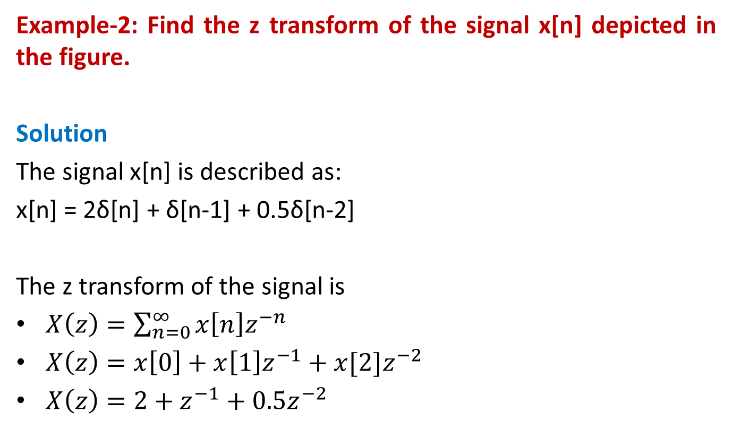
Z Transform
Example-2: Find the z transform of the signal x[n] depicted in the figure.
Solution
The signal x[n] is described as:
x[n] = 2δ[n] + δ[n-1] + 0.5δ[n-2]
The z transform of the signal is
$X\left(z\right)=\sum_{n=0}^{∞}{x\left[n\right]z^{−n}}$
$X\left(z\right)=x\left[0\right]+x\left[1\right]z^{−1}+x[2]z^{−2}$
$X\left(z\right)=2+z^{−1}+0.5z^{−2}$

Slide 18
Properties of z-transform
Linearity

Slide 19
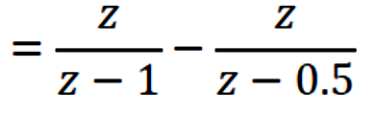
Properties of z-transform
Linearity
Example-3: Find the z-transform of the sequence defined by
Solution
Applying the linearity of the z-transform, we have

Slide 20
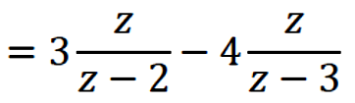
Properties of z-transform
Linearity
Example-4: Find the z-transform of the sequence defined by
Solution
Applying the linearity of the z-transform, we have

Slide 21
Properties of z-transform
Linearity
Example-5: Find the z-transform of the signal x[n] defined by
Solution
Applying the linearity of the z-transform, we have

Slide 22
Properties of z-transform
Time Shifting/Shift Theorem
A one-sample delay in the time domain appears in the z domain as a z⁻¹ factor. That is,
Z{x[n-1]} = z⁻¹X(z)
More generally,
Z{x[n-k]} = z^{-k}X(z)

Slide 23
Properties of z-transform
Time Shifting/Shift Theorem

Slide 24
Properties of z-transform
Time Shifting/Shift Theorem

Slide 25
Properties of z-transform
Time Reversal

Slide 26
Properties of z-transform
Time Reversal
Example-7: Find the z-transform of the signal x[n] = u[-n]
Solution
Applying the time reversal theorem of the z-transform, we have

Slide 27
Properties of z-transform
Convolution
Convolution in time domain is equal to the multiplication in frequency domain and vice versa.

Slide 28
Properties of z-transform
Convolution
Proof:

Slide 29
Properties of z-transform
Convolution
Example-8: Consider the two sequences
Find the Z transform of convolution
Determine the convolution sum using the z-transform.
Solution

Slide 30
Properties of z-transform
Convolution
Example-9: Compute the convolution of the following signals using z transform
Solution

Slide 31
Properties of z-transform

Slide 32
Difference Equation Diagram using z^{–1} Notation
Time shifting property of the z transform suggests a notation change for difference equation diagram.
The delay blocks can be replaced by z⁻¹ bocks.
This convention mixes the time and z domain notations.

Slide 33
Difference Equation Diagram using z^{–1} Notation
The general form of the non-recursive difference equation is
y[n] = b₀x[n] + b₁x[n-1] + b₂x[n-2] + … + b_{M}x[n-M]
Re-expressing the non-recursive difference equation diagram using the z⁻¹ notation.

Slide 34
Transfer Function

Slide 35
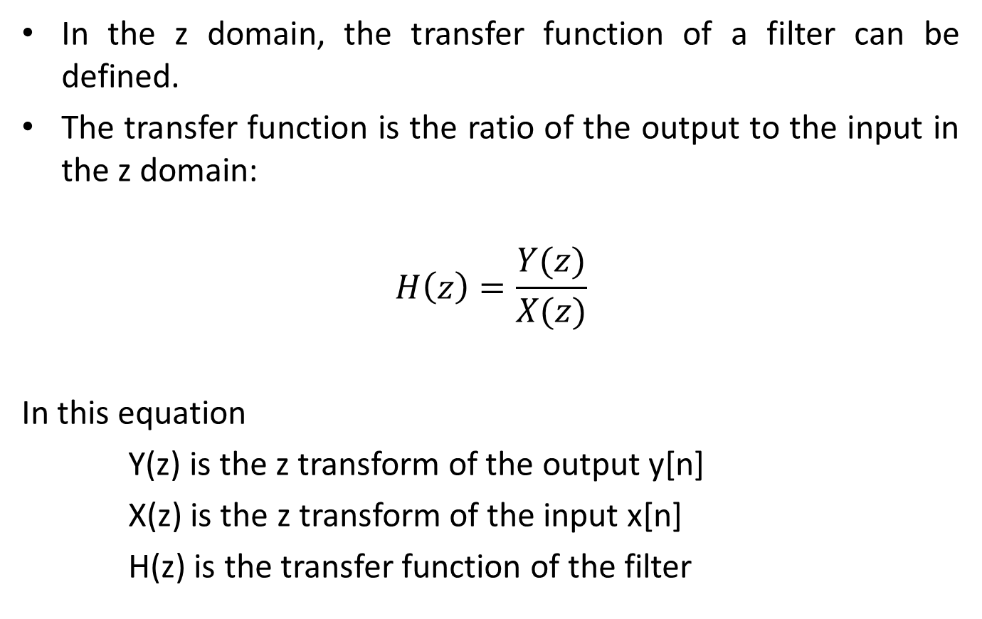
Transfer Function
In the z domain, the transfer function of a filter can be defined.
The transfer function is the ratio of the output to the input in the z domain:
$$H\left(z\right)=\frac{Y(z)}{X(z)}$$
In this equation
Y(z) is the z transform of the output y[n]
X(z) is the z transform of the input x[n]
H(z) is the transfer function of the filter

Slide 36
Transfer Function & Difference Equation
The general form of a difference equation is
a₀y[n] + a₁y[n-1] + a₂y[n-2] + … + a_{N}y[n-N]
= b₀x[n] + b₁x[n-1] + b₂x[n-2] + … + b_{M}x[n-M]
Taking the z transform of the above equation
a₀Y(z)+ a₁z⁻¹Y(z)+ a₂z⁻²Y(z) + … + a_{N}z^{-N}Y(z)
= b₀X(z) + b₁z⁻¹X(z) + b₂z⁻²X(z) + … + b_{M}z^{-M}X(z)
Taking Y(Z) and X(Z) common and then cross multiply to get TF.

Slide 37
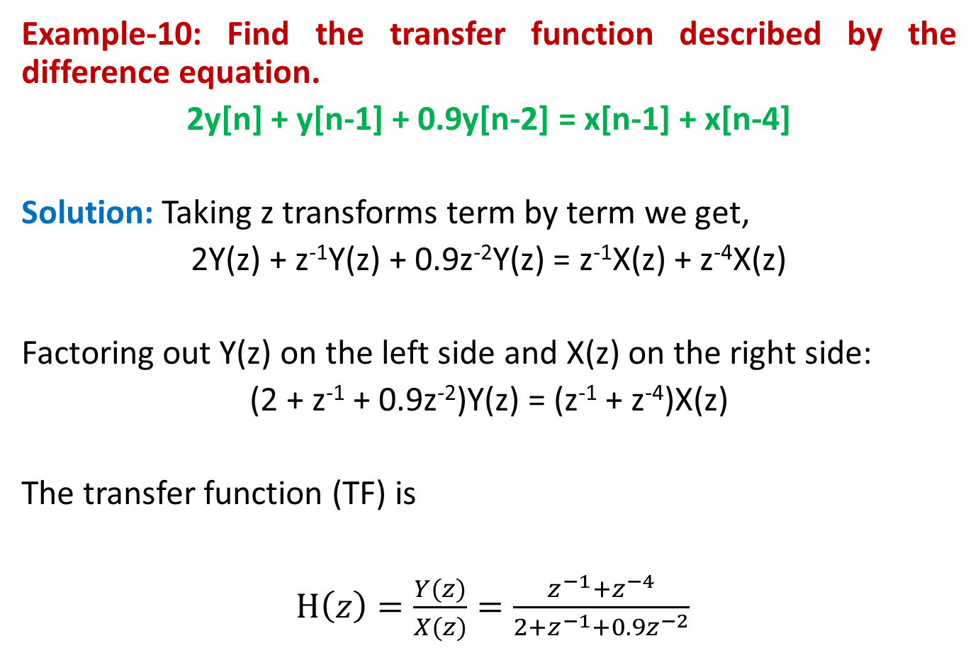
Transfer Function & Difference Equation
Example-10: Find the transfer function described by the difference equation.
2y[n] + y[n-1] + 0.9y[n-2] = x[n-1] + x[n-4]
Solution: Taking z transforms term by term we get,
2Y(z) + z⁻¹Y(z) + 0.9z⁻²Y(z) = z⁻¹X(z) + z⁻⁴X(z)
Factoring out Y(z) on the left side and X(z) on the right side:
(2 + z⁻¹ + 0.9z⁻²)Y(z) = (z⁻¹ + z⁻⁴)X(z)
The transfer function (TF) is
$H\left(z\right)=\frac{Y(z)}{X(z)}=\frac{z^{−1}+z^{−4}}{2+z^{−1}+0.9z^{−2}}$

Slide 38
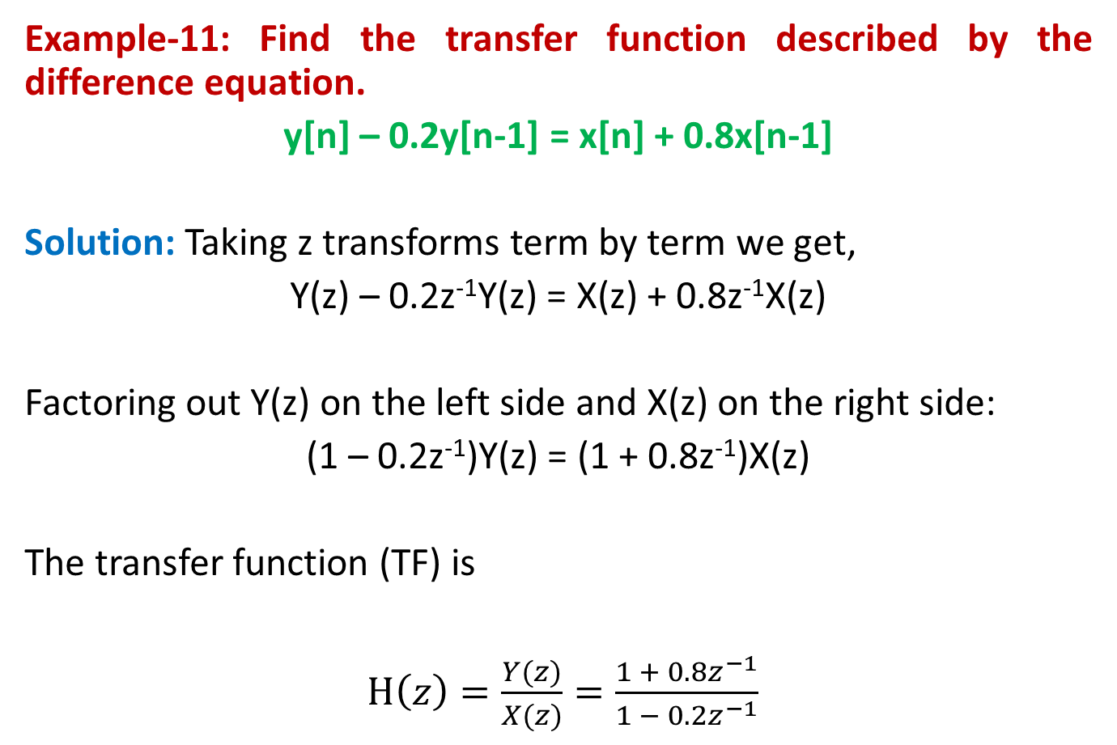
Transfer Function & Difference Equation
Example-11: Find the transfer function described by the difference equation.
y[n] – 0.2y[n-1] = x[n] + 0.8x[n-1]
Solution: Taking z transforms term by term we get,
Y(z) – 0.2z⁻¹Y(z) = X(z) + 0.8z⁻¹X(z)
Factoring out Y(z) on the left side and X(z) on the right side:
(1 – 0.2z⁻¹)Y(z) = (1 + 0.8z⁻¹)X(z)
The transfer function (TF) is
$H\left(z\right)=\frac{Y(z)}{X(z)}=\frac{1 + 0.8z^{−1}}{1 − 0.2z^{−1}}$

Slide 39
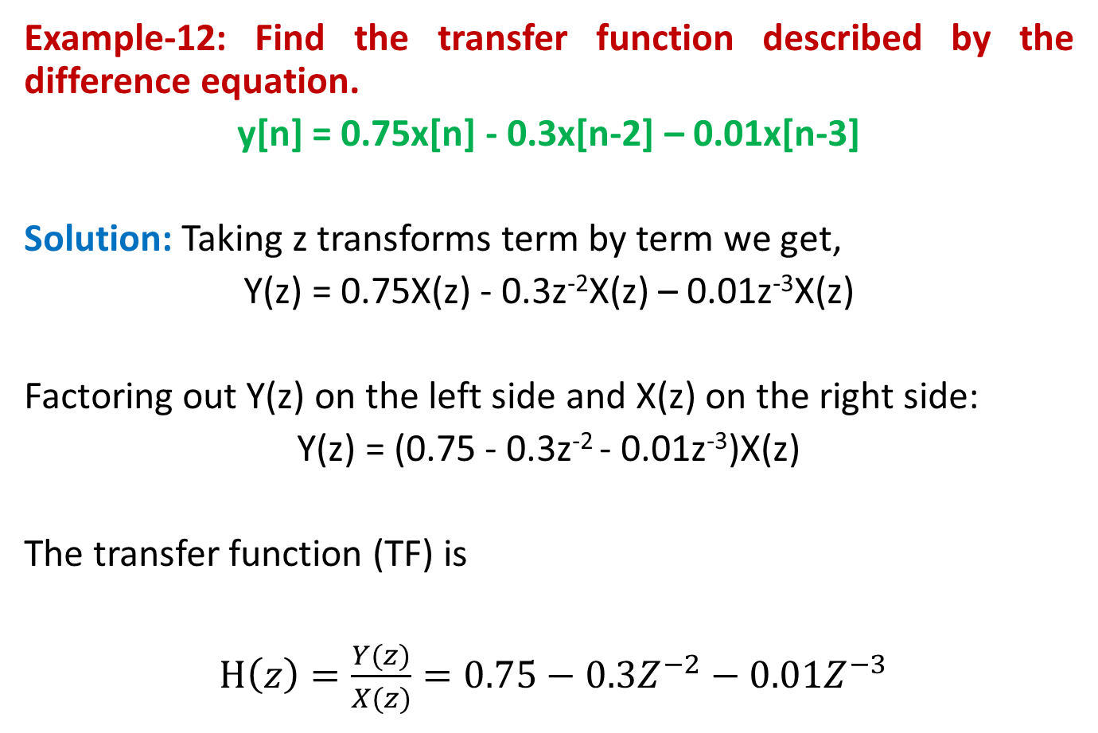
Transfer Function & Difference Equation
Example-12: Find the transfer function described by the difference equation.
y[n] = 0.75x[n] - 0.3x[n-2] – 0.01x[n-3]
Solution: Taking z transforms term by term we get,
Y(z) = 0.75X(z) - 0.3z⁻²X(z) – 0.01z⁻³X(z)
Factoring out Y(z) on the left side and X(z) on the right side:
Y(z) = (0.75 - 0.3z⁻² - 0.01z⁻³)X(z)
The transfer function (TF) is
$H\left(z\right)=\frac{Y(z)}{X(z)}=0.75−0.3Z^{−2}−0.01Z^{−3}$

Slide 40
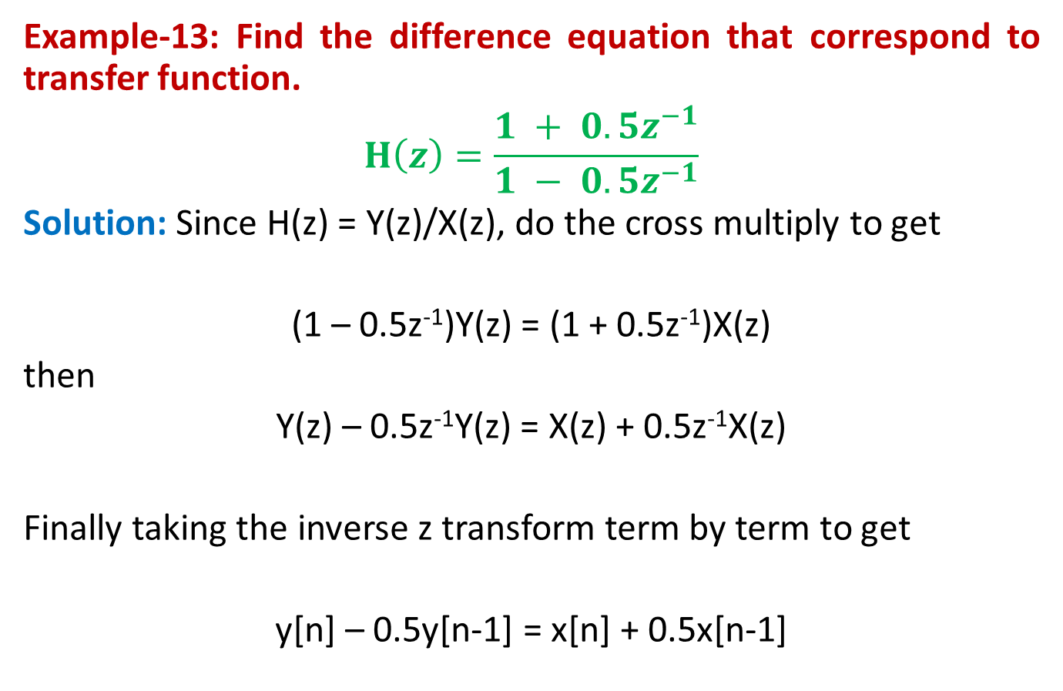
Transfer Function & Difference Equation
Example-13: Find the difference equation that correspond to transfer function.
$$H\left(z\right)=\frac{1 + 0.5z^{−1}}{1 − 0.5z^{−1}}$$
Solution: Since H(z) = Y(z)/X(z), do the cross multiply to get
(1 – 0.5z⁻¹)Y(z) = (1 + 0.5z⁻¹)X(z)
then
Y(z) – 0.5z⁻¹Y(z) = X(z) + 0.5z⁻¹X(z)
Finally taking the inverse z transform term by term to get
y[n] – 0.5y[n-1] = x[n] + 0.5x[n-1]

Slide 41
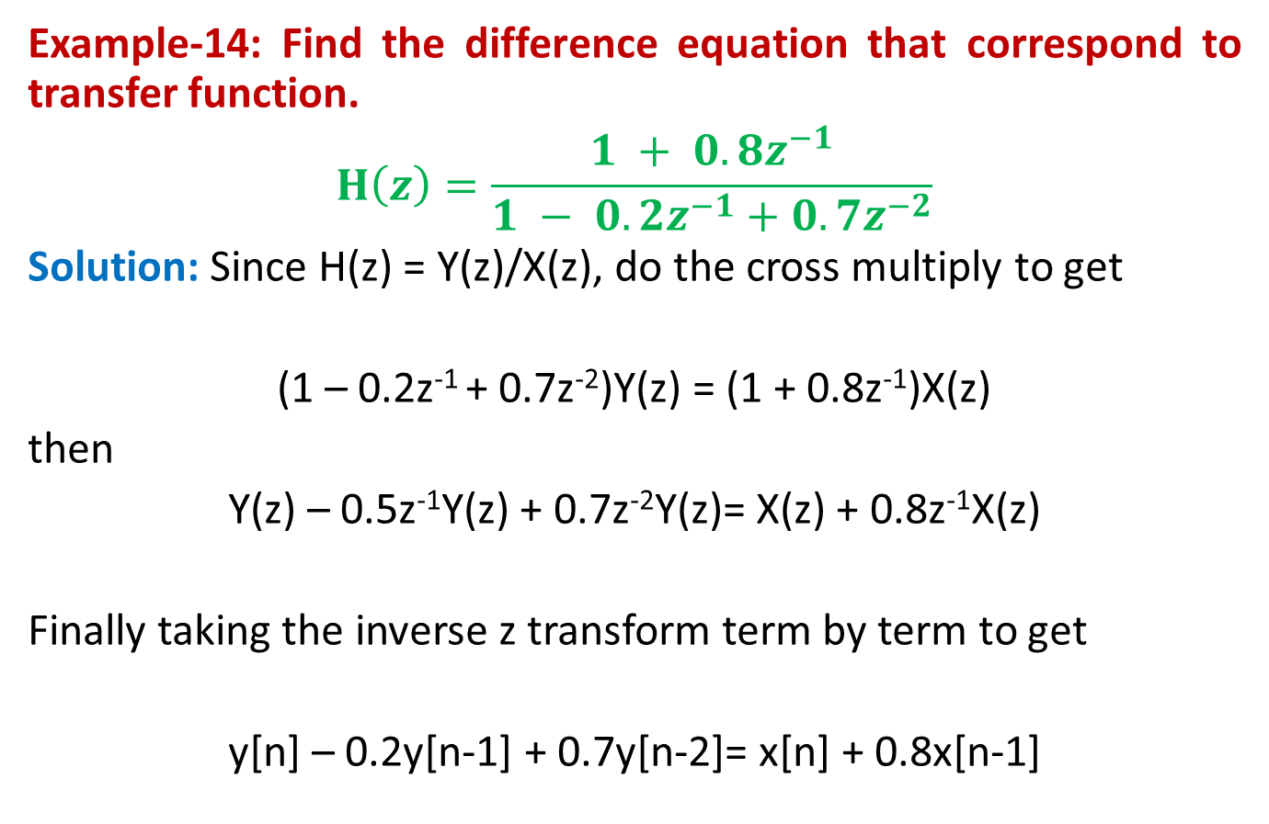
Transfer Function & Difference Equation
Example-14: Find the difference equation that correspond to transfer function.
$$H\left(z\right)=\frac{1 + 0.8z^{−1}}{1 − 0.2z^{−1}+0.7z^{−2}}$$
Solution: Since H(z) = Y(z)/X(z), do the cross multiply to get
(1 – 0.2z⁻¹ + 0.7z⁻²)Y(z) = (1 + 0.8z⁻¹)X(z)
then
Y(z) – 0.5z⁻¹Y(z) + 0.7z⁻²Y(z)= X(z) + 0.8z⁻¹X(z)
Finally taking the inverse z transform term by term to get
y[n] – 0.2y[n-1] + 0.7y[n-2]= x[n] + 0.8x[n-1]

Slide 42
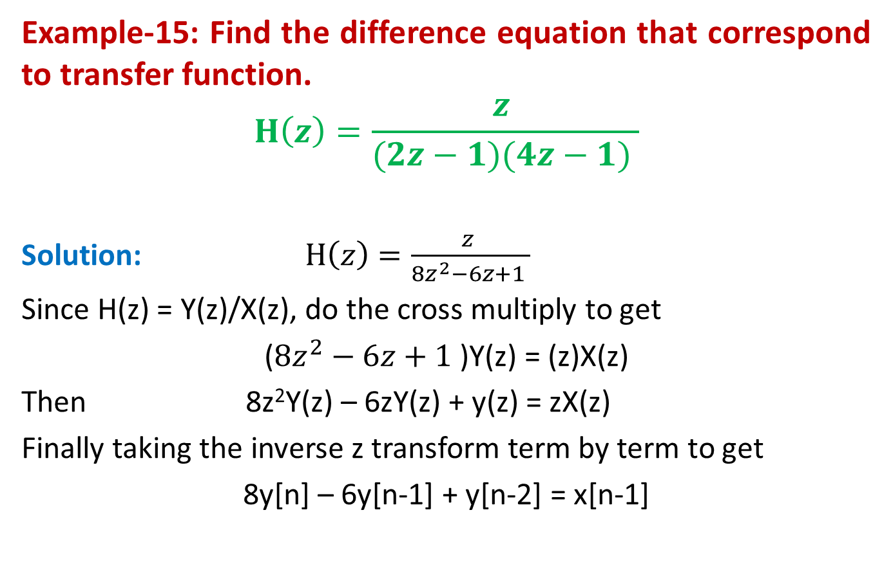
Transfer Function & Difference Equation
Example-15: Find the difference equation that correspond to transfer function.
$$H\left(z\right)=\frac{z }{(2z−1)(4z−1) }$$
Solution: $H\left(z\right)=\frac{z }{8z^{2}−6z+1 }$
Since H(z) = Y(z)/X(z), do the cross multiply to get
($8z^{2}−6z+1$)Y(z) = (z)X(z)
Then 8z²Y(z) – 6zY(z) + y(z) = zX(z)
Finally taking the inverse z transform term by term to get
8y[n] – 6y[n-1] + y[n-2] = x[n-1]

Slide 43
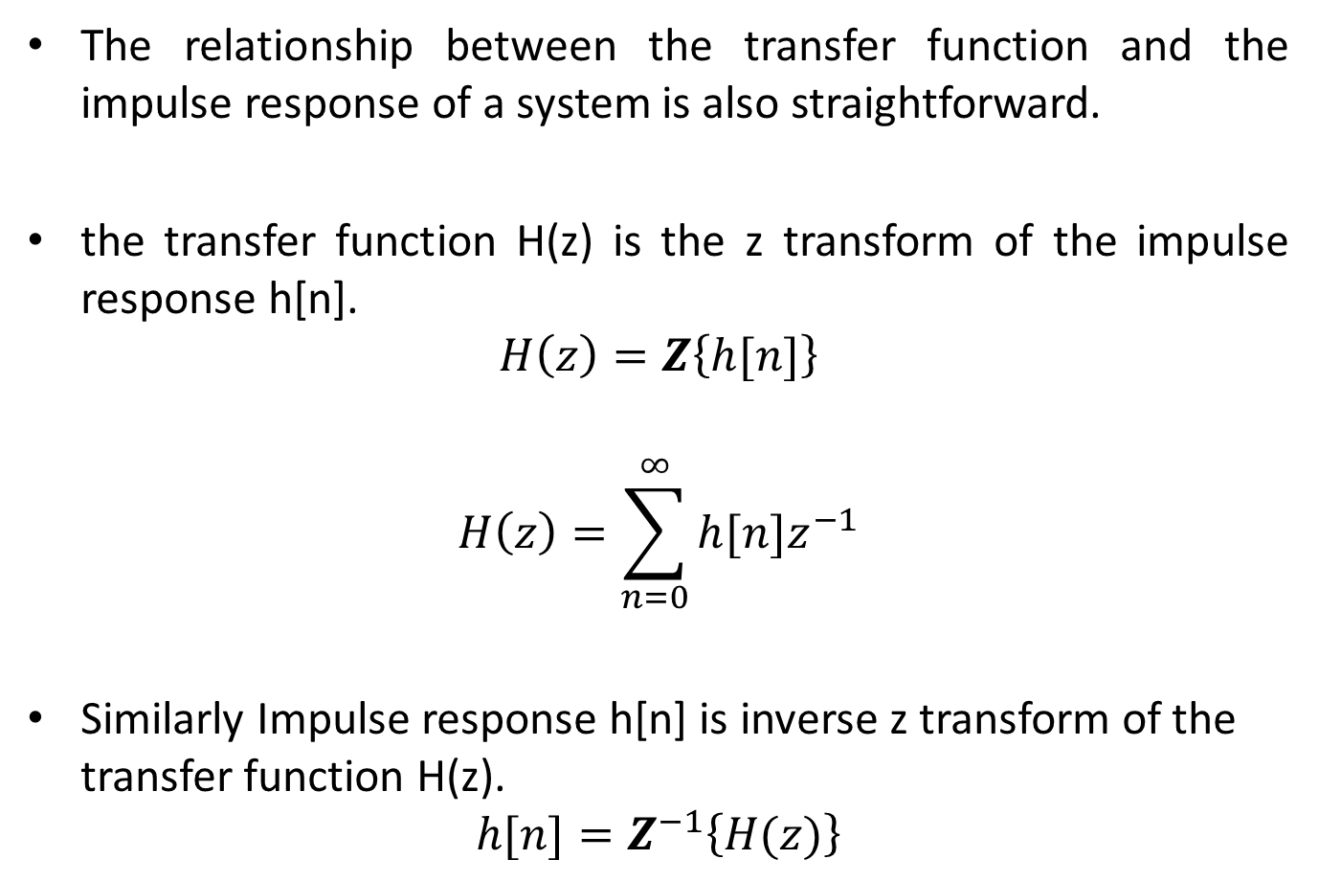
Transfer Function & Impulse Response
The relationship between the transfer function and the impulse response of a system is also straightforward.
the transfer function H(z) is the z transform of the impulse response h[n].
$$H\left(z\right)=Z\left\{h[n]\right\}$$
$$H\left(z\right)=\sum_{n=0}^{∞}{h[n]z^{−1}}$$
Similarly Impulse response h[n] is inverse z transform of the transfer function H(z).
$$h[n]=Z^{−1}\left\{H(z)\right\}$$

Slide 44
Transfer Function & Impulse Response
Example-16: Find the transfer function of the system whose impulse response is
h[n] = δ[n] + 0.4 δ[n-1] + 0.2 δ[n-2] + 0.05 δ[n-3]
Solution
The transfer function H(z) of the system is the z transform of the impulse response h[n]. Taking z transform term by term we get
H(z) = 1 + 0.4z⁻¹ + 0.2z⁻² + 0.05z⁻³
Note that we can also get the difference equation from the TF.
y[n] = x[n] + 0.4x[n-1] + 0.2x[n-2]+ 0.05x[n-3]

Slide 45
System Outputs in Time & Z Domains
The system output can be find using three different ways.

Slide 46
System Output using TF
The definition of the transfer function (TF) provides a means of calculating filter outputs. That is,
Y(z) = H(z)X(z)
To determine the time domain output y[n], the inverse z transform of Y(z) must be taken.

Slide 47
Inverse Z Transform

Slide 48
Inverse Z Transform
To convert a function in the z domain into a function in the time domain requires an inverse z transform.
This conversion is necessary, for example, to find the time domain functions like
x[n] that correspond to the z transforms X(z)
y[n] that correspond to the z transforms Y(z)
h[n] impulse response from a transfer function H(z)

Slide 49
Inverse Z Transform
There are several ways of finding inverse z transforms:
A: Formal Method
Contour Integration
B: Informal Methods
1- Inspection method using Z Transform Tables
2- Long Division (Synthetic Division or Power Series Expansion)
3- Partial Fraction Expansion

Slide 50
Inverse Z Transform
A: Formal Method
Contour Integration:
where C represents a closed contour within the ROC of the z-transform.
The most fundamental method for the inversion of z transform is the general inversion method which is based on the Laurent theorem.
The contour integral of the above equation can be evaluated using the residue theorem.

Slide 51
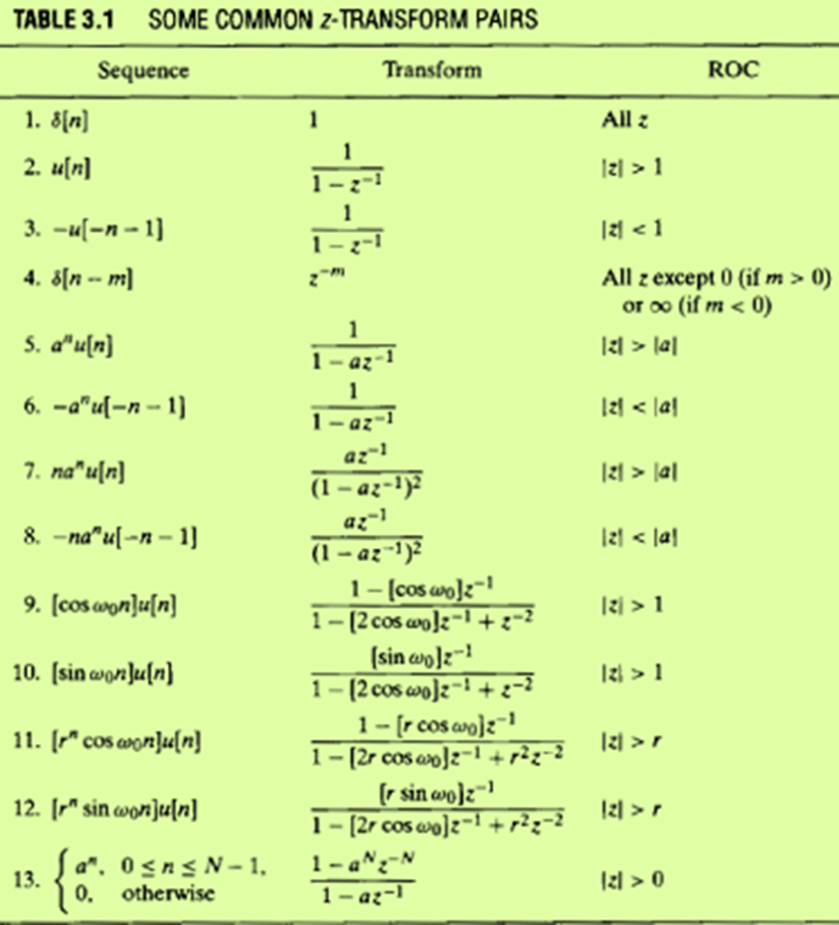

Inspection Method using Z Transform Tables
Example-17: Find the x[n] that corresponds to the z transform
$$X\left(z\right)=\frac{z}{z−0.8}$$
Solution
Using z transform table, the inverse z transform is
$$x\left[n\right]= Z^{−1}\left\{X(z)\right\}$$
$$x\left[n\right]={(0.8)}^{n}u[n]$$

Slide 52

Inspection Method using Z Transform Tables
Example-18: Find the inverse z transform of the function
$$X\left(z\right)=\frac{z^{2}−0.9z}{z^{2}−1.8z+1}$$
Using z transform table, the inverse z transform is
$$x\left[n\right]= Z^{−1}\left\{X(z)\right\}$$
$$X\left(z\right)=\frac{z^{2}−0.9z}{z^{2}−1.8z+1}$$
cosΩ = 0.9
Ω = cos-1(0.9) = 0.451
$$x\left[n\right]=cos⁡(nΩ)u[n]$$
$$x\left[n\right]=cos⁡(0.451Ω)u[n]$$

Slide 53
Long Division Method
ADVANTGES
Relatively straight forward method
Applicable to any rational function
Can be use to convert improper rational function into proper rational function
DISADVANTAGES
Sometimes will run to infinity
General close-form solution cannot be found

Slide 54
Transfer Function & System Stability
Transfer function can be expressed as a rational function consist of numerator polynomial divided by denominator polynomial.
The highest power in a polynomial is called its degree.
In a proper rational function, the degree of the numerator is less than or equal to the degree of the denominator.
In a strictly proper rational function, the degree of the numerator is less than or the degree of the denominator.
In an improper rational function, the degree of the numerator is greater than the degree of the denominator.

Slide 55
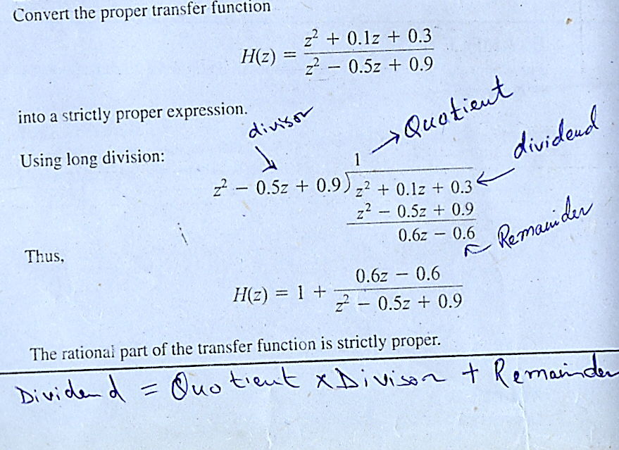
Long Division Method

Slide 56
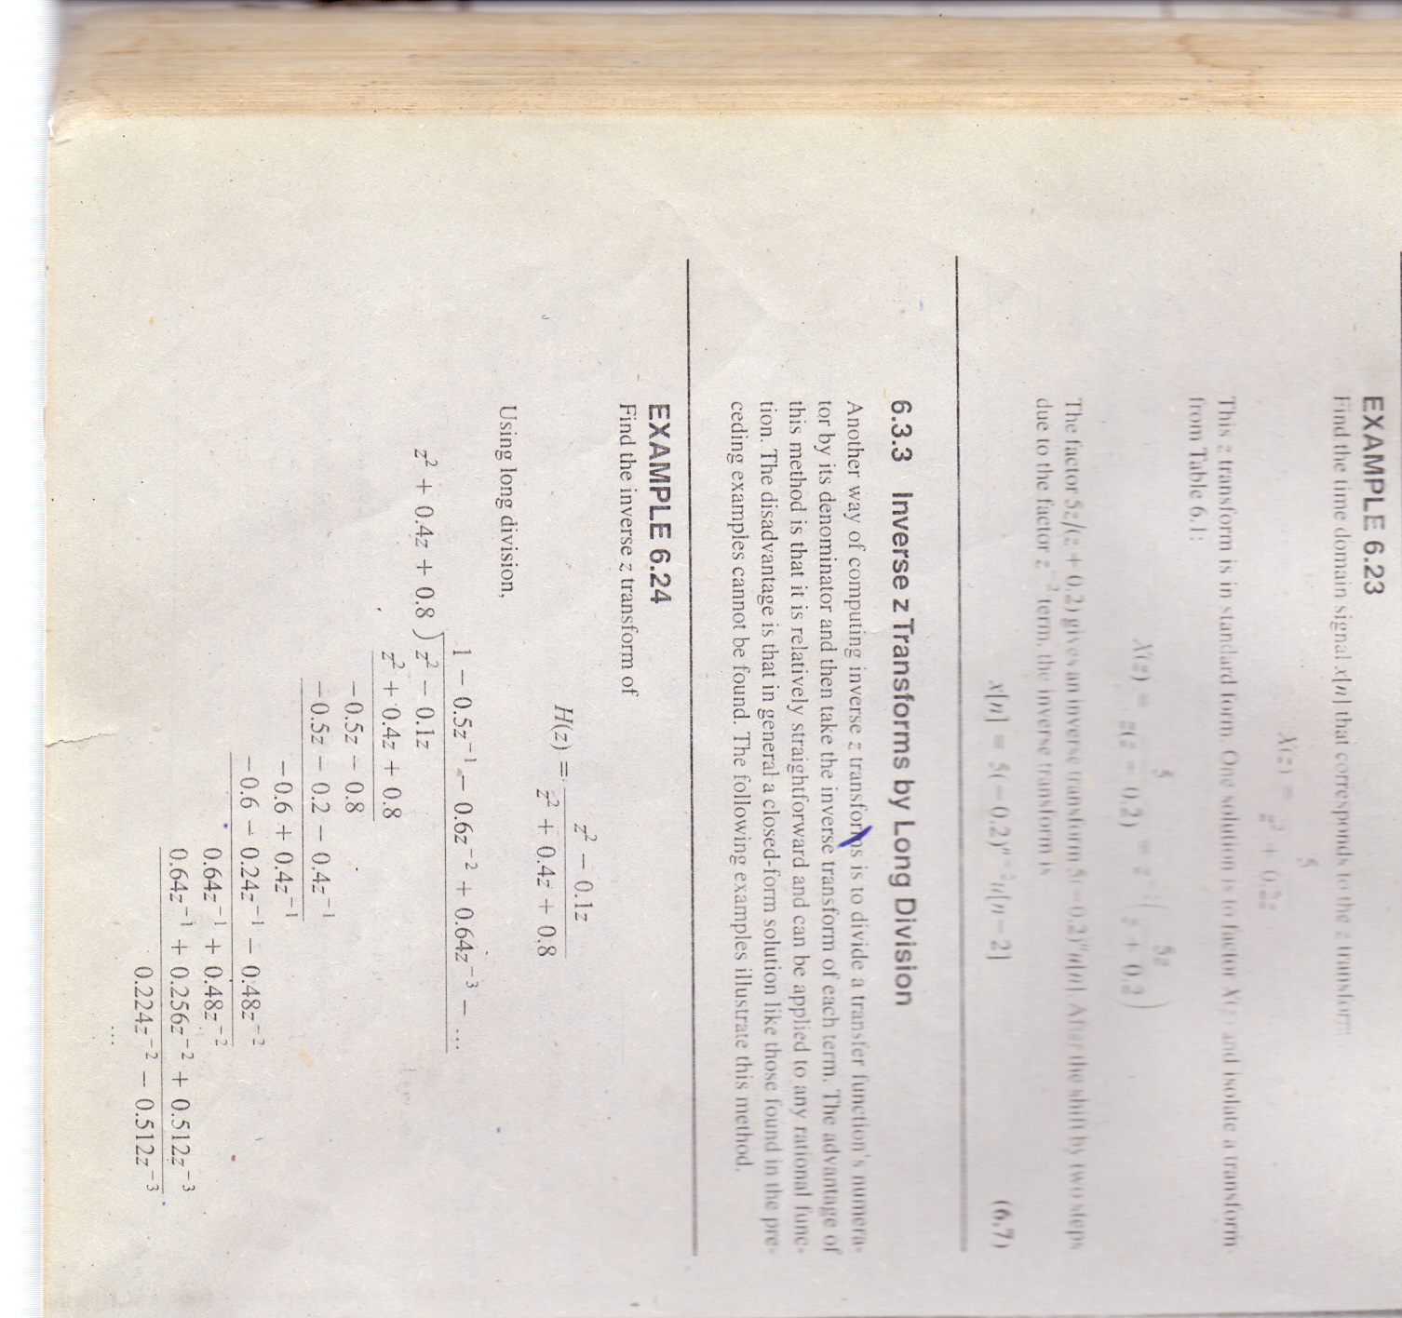
Long Division Method
Example-19: Using long division method, determine the inverse z-transform of
H(z) = 1 – 0.5z⁻¹ - 0.6z⁻² + 0.64z⁻³ + …
The inverse Z transform is h[n] = δ[n] – 0.5δ[n-1] – 0.6δ[n-2] + 0.64δ[n-3] + …

Slide 57
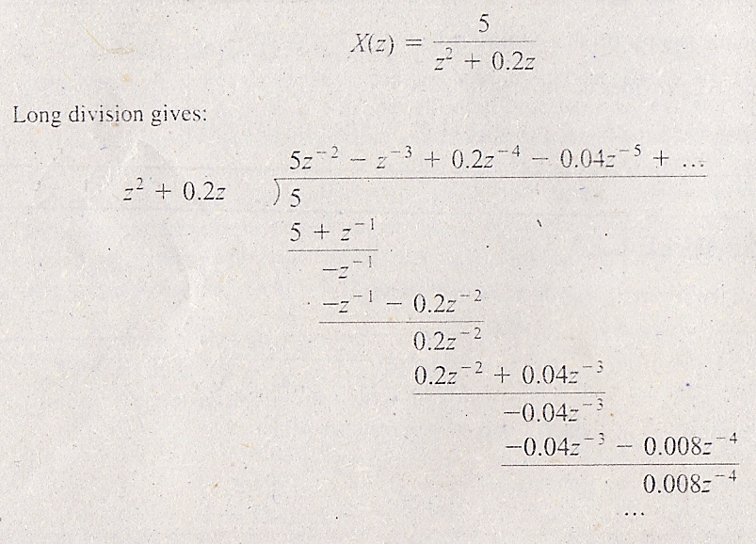
Long Division Method
Example-20: Using long division method, determine the inverse z-transform of
X(z) = 5z⁻² – z⁻³ + 0.2z⁻⁴ – 0.04z⁻⁵ + …
The inverse Z transform is x[n] = 5δ[n-2] – δ[n-3] + 0.2δ[n-4] – 0.04 δ[n-5] + …

Slide 58
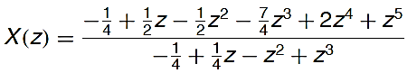
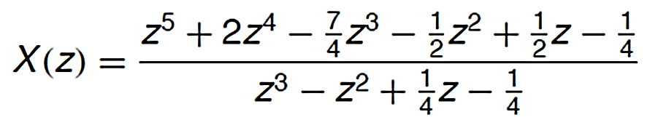
Long Division Method
Example-21: Using long division method, determine the inverse z-transform of
Solution: First arranged in descending powers of Z
then dividing the numerator of 𝑋(𝑧) by its denominator we obtain power series

Slide 59
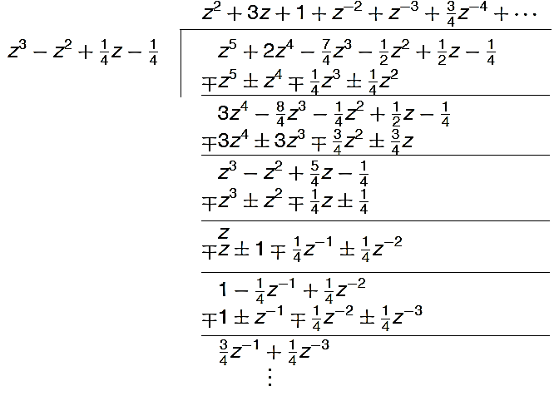
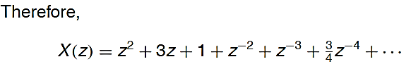
Long Division Method
The inverse Z transform is x[n] = δ[n+2] + 3δ[n] + δ[n] + δ[n-2] + δ[n-3] + δ[n-4] + …

Slide 60
Long Division Method
Example-22: Using long division method, determine the inverse z-transform of
Solution: By dividing the numerator of 𝑋(𝑧) by its denominator we obtain power series
Using z-transform table
or

Slide 61
Long Division Method
Example-23: Using long division method, determine the inverse z-transform of
Solution: By dividing the numerator of 𝑋(𝑧) by its denominator we obtain power series
Using z-transform table
or

Slide 62
Partial Fraction Method
ADVANTGES
It decompose the higher order system into sum of lower order system
General close-form solution can be found
DISADVANTAGES
Applicable to strictly proper rational function in standard form
Getting complex by handling 3 different types of roots for a polynomial function of z, i.e.,
1. Distinct Real Roots
2. Repeated Real Roots
3. Complex Conjugate Roots

Slide 63
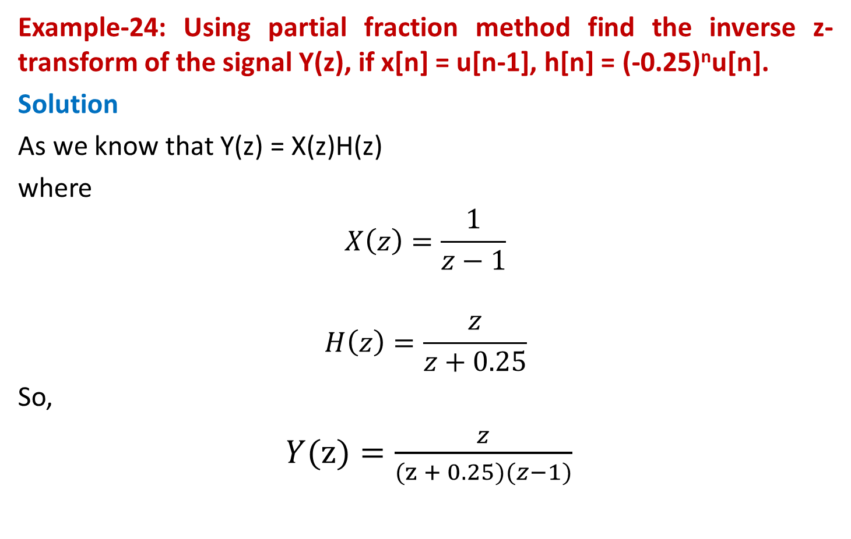
Partial Fraction Method
Example-24: Using partial fraction method find the inverse z-transform of the signal Y(z), if x[n] = u[n-1], h[n] = (-0.25)^{n}u[n].
Solution
As we know that Y(z) = X(z)H(z)
where
$$X\left(z\right)=\frac{1}{z−1}$$
$$H\left(z\right)=\frac{z}{z+0.25}$$
So,
$Y(z)=\frac{z}{(z + 0.25)(z−1)}$

Slide 64
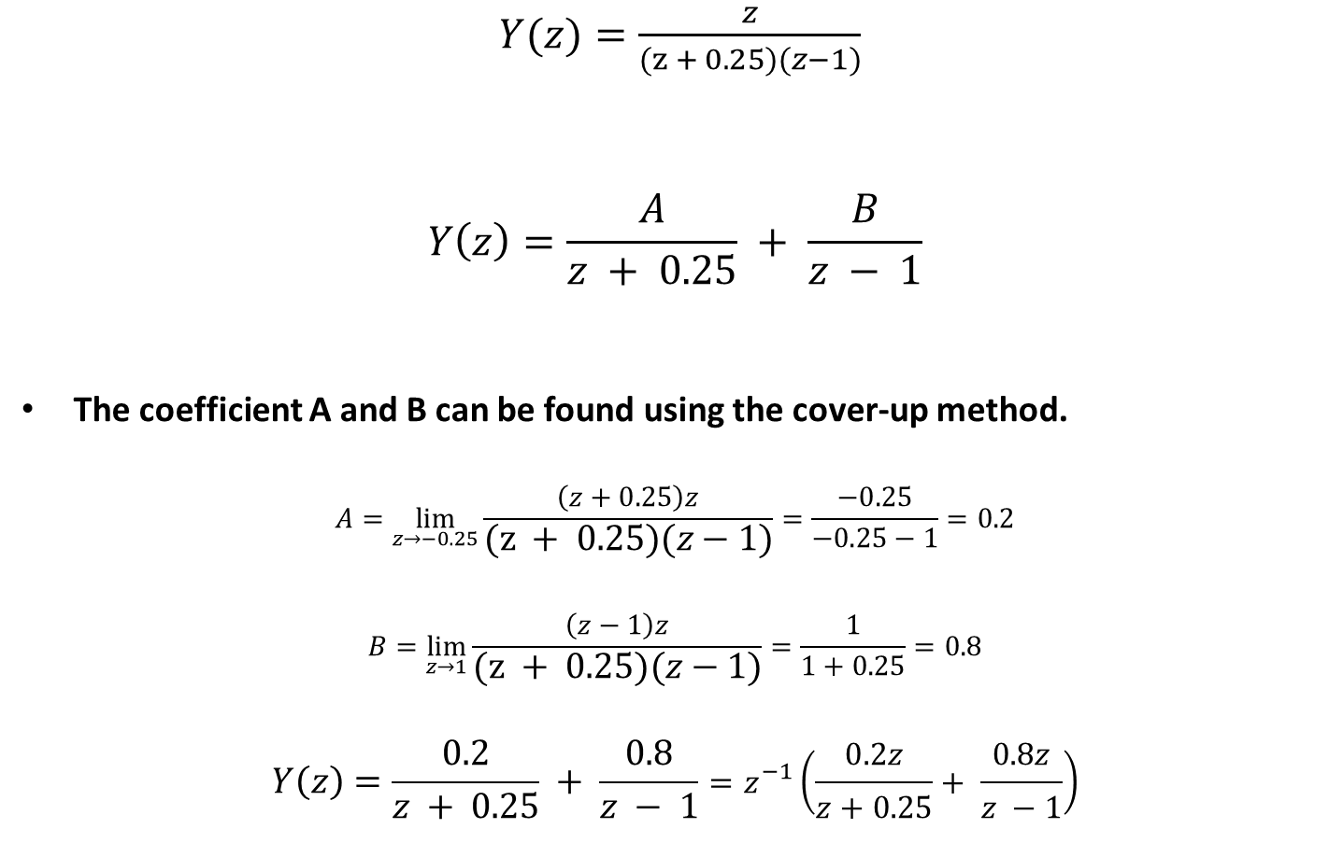
Partial Fraction Method
$Y(z)=\frac{z}{(z + 0.25)(z−1)}$
$$Y\left(z\right)=\frac{A}{z + 0.25} + \frac{B}{z − 1}$$
The coefficient A and B can be found using the cover-up method.
$$A=\lim_{z→−0.25}{\frac{\left(z+0.25\right)z}{(z + 0.25)(z−1)}}=\frac{−0.25}{−0.25−1}=0.2$$
$$B=\lim_{z→1}{\frac{\left(z−1\right)z}{(z + 0.25)(z−1)}}=\frac{1}{1+0.25}=0.8$$
$$Y\left(z\right)=\frac{0.2}{z + 0.25} + \frac{0.8}{z − 1}=z^{−1}\left(\frac{0.2z}{z+0.25}+ \frac{0.8z}{z −1}\right)$$
The partial fraction expansion is

Slide 65
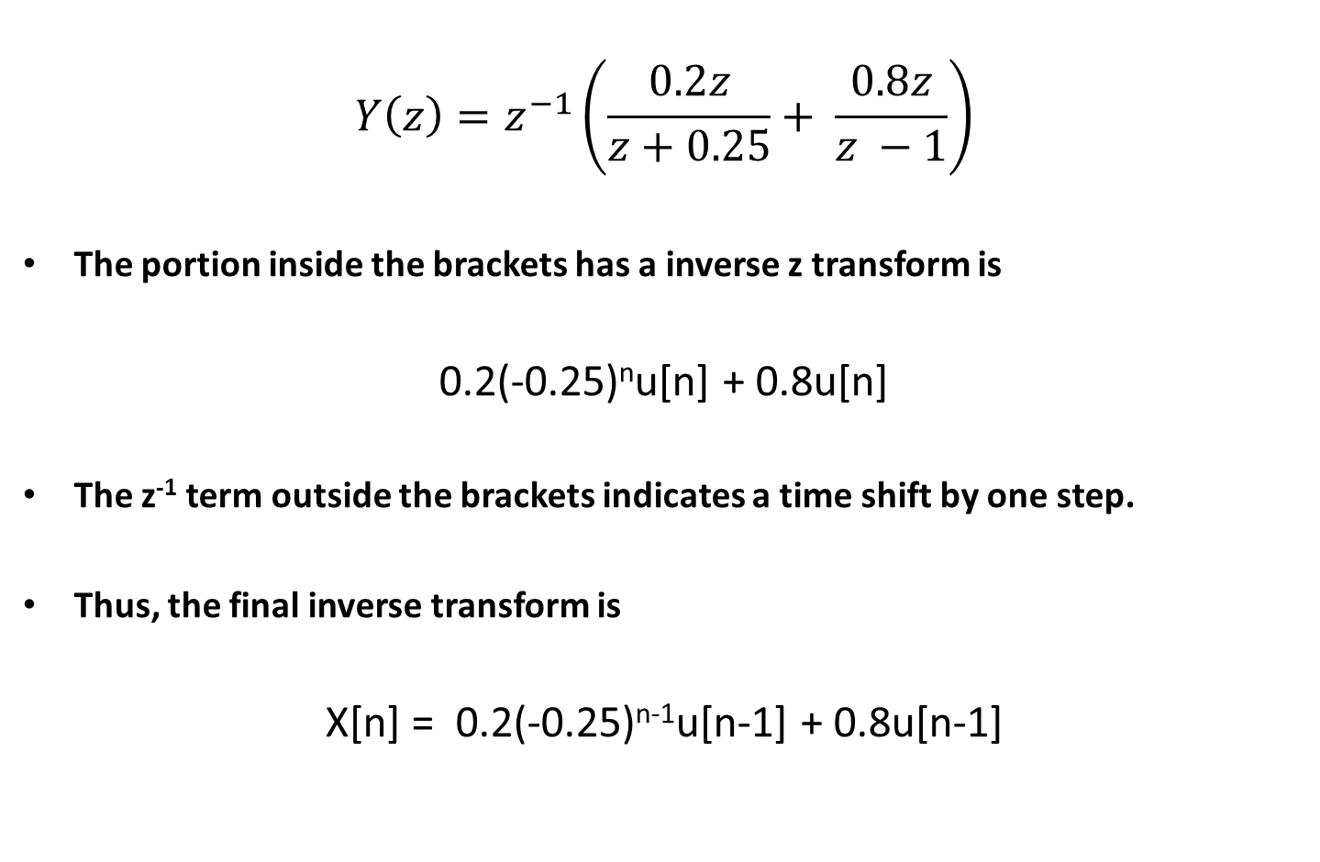
Partial Fraction Method
$$Y\left(z\right)=z^{−1}\left(\frac{0.2z}{z+0.25}+ \frac{0.8z}{z −1}\right)$$
The portion inside the brackets has a inverse z transform is
0.2(-0.25)^{n}u[n] + 0.8u[n]
The z⁻¹ term outside the brackets indicates a time shift by one step.
Thus, the final inverse transform is
X[n] = 0.2(-0.25)^{n-1}u[n-1] + 0.8u[n-1]

Slide 66

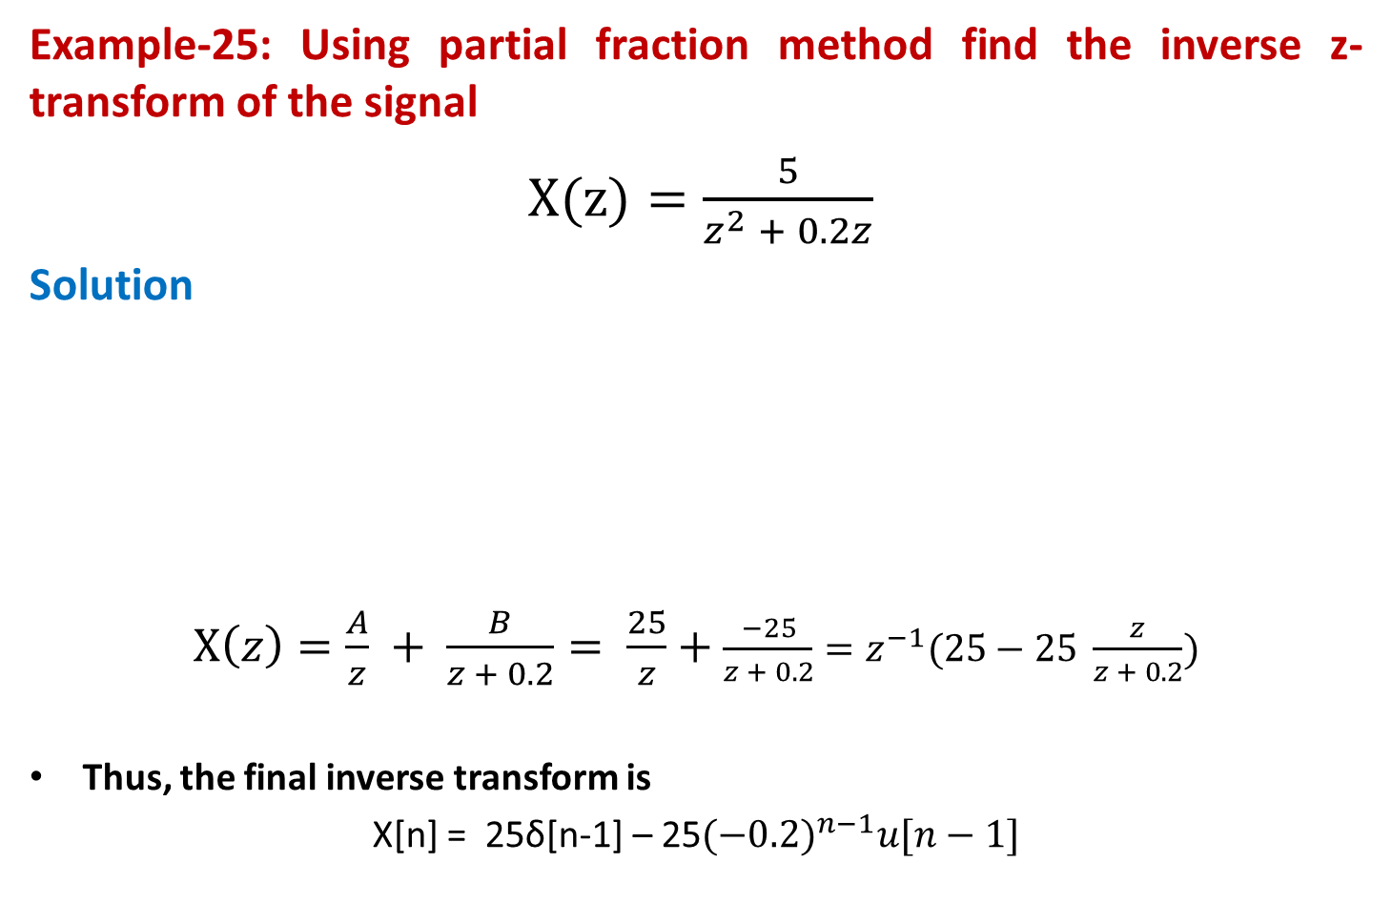
Partial Fraction Method
Example-25: Using partial fraction method find the inverse z-transform of the signal
$X(z)=\frac{5}{z^{2} + 0.2z}$
Solution
$X\left(z\right)=\frac{A}{z} + \frac{B}{z + 0.2}= \frac{25}{z}+$ $\frac{−25}{z + 0.2}=z^{−1}(25−25 \frac{z}{z + 0.2})$
Thus, the final inverse transform is
X[n] = 25δ[n-1] – 25${(−0.2)}^{n−1}u[n−1]$
The denominator of X(z) can be factored to give
$$X(z)=\frac{5}{z(z + 0.2)}$$
The partial fraction expansion is

Slide 67
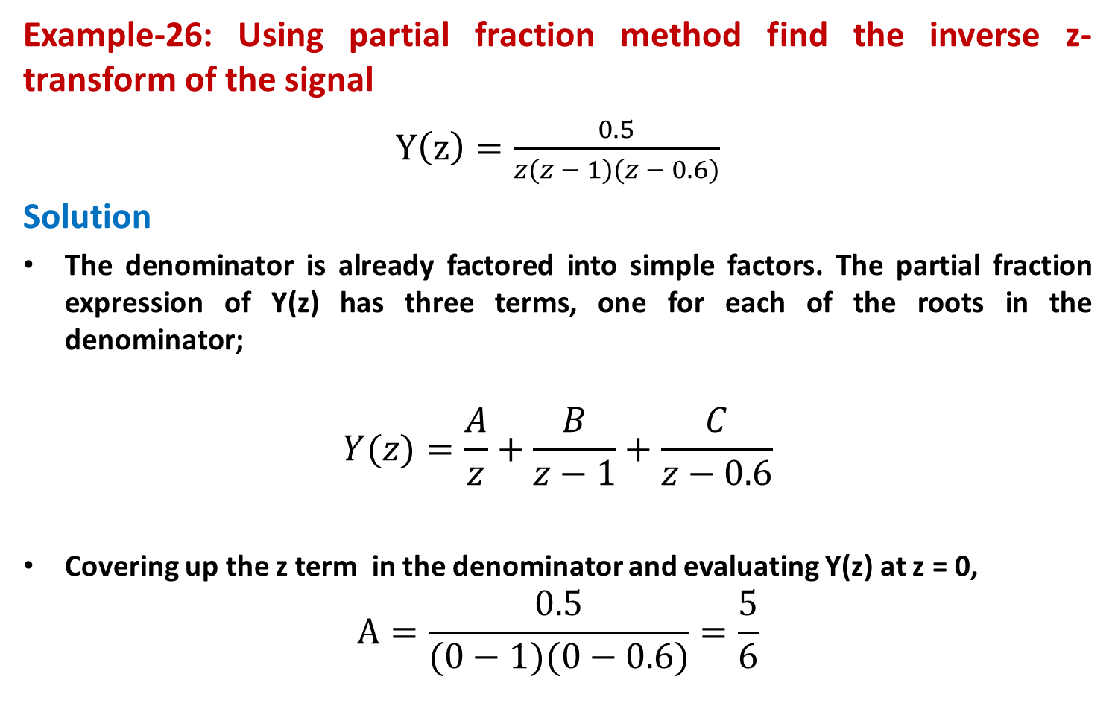
Partial Fraction Method
Example-26: Using partial fraction method find the inverse z-transform of the signal
$Y\left(z\right)=\frac{0.5}{z(z − 1)(z − 0.6)}$
Solution
The denominator is already factored into simple factors. The partial fraction expression of Y(z) has three terms, one for each of the roots in the denominator;
$$Y(z)=\frac{A}{z}+\frac{B}{z−1}+\frac{C}{z−0.6}$$
Covering up the z term in the denominator and evaluating Y(z) at z = 0, $A=\frac{0.5}{(0−1)(0−0.6)}=\frac{5}{6}$

Slide 68
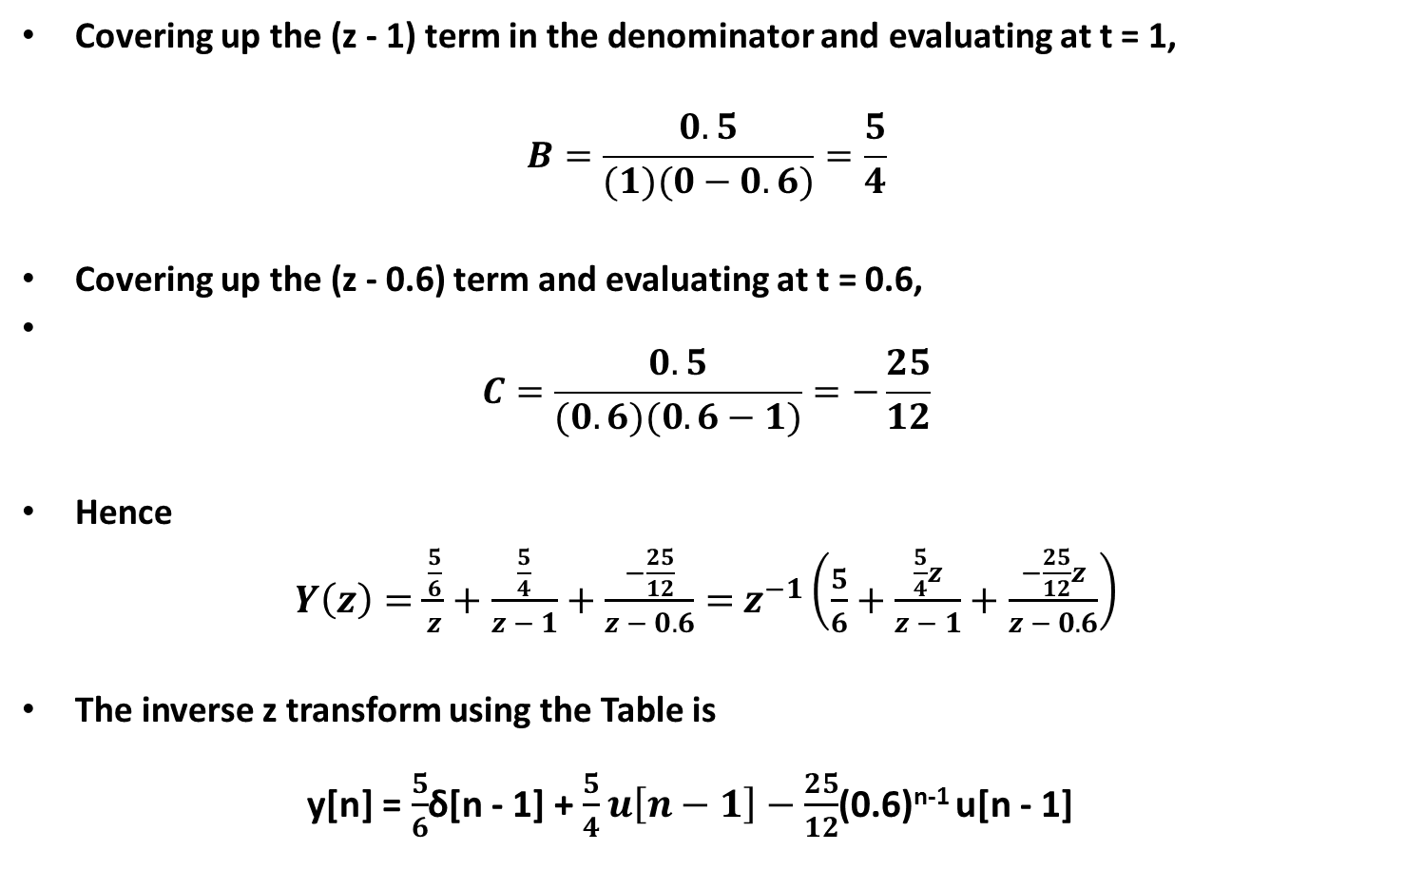
Partial Fraction Method
Covering up the (z - 1) term in the denominator and evaluating at t = 1,
$$B=\frac{0.5}{(1)(0−0.6)}=\frac{5}{4}$$
Covering up the (z - 0.6) term and evaluating at t = 0.6,
$C=\frac{0.5}{(0.6)(0.6−1)}=−\frac{25}{12}$
Hence
$Y\left(z\right)=\frac{\frac{5}{6}}{z}+\frac{\frac{5}{4}}{z − 1}+\frac{−\frac{25}{12}}{z − 0.6}=$ $z^{−1}\left(\frac{5}{6}+\frac{\frac{5}{4}z}{z − 1}+\frac{−\frac{25}{12}z}{z − 0.6}\right)$
The inverse z transform using the Table is y[n] =$\frac{5}{6}$δ[n - 1] +$\frac{5}{4}u\left[n−1\right]−\frac{25}{12}$(0.6)^{n-1} u[n - 1]

Slide 69
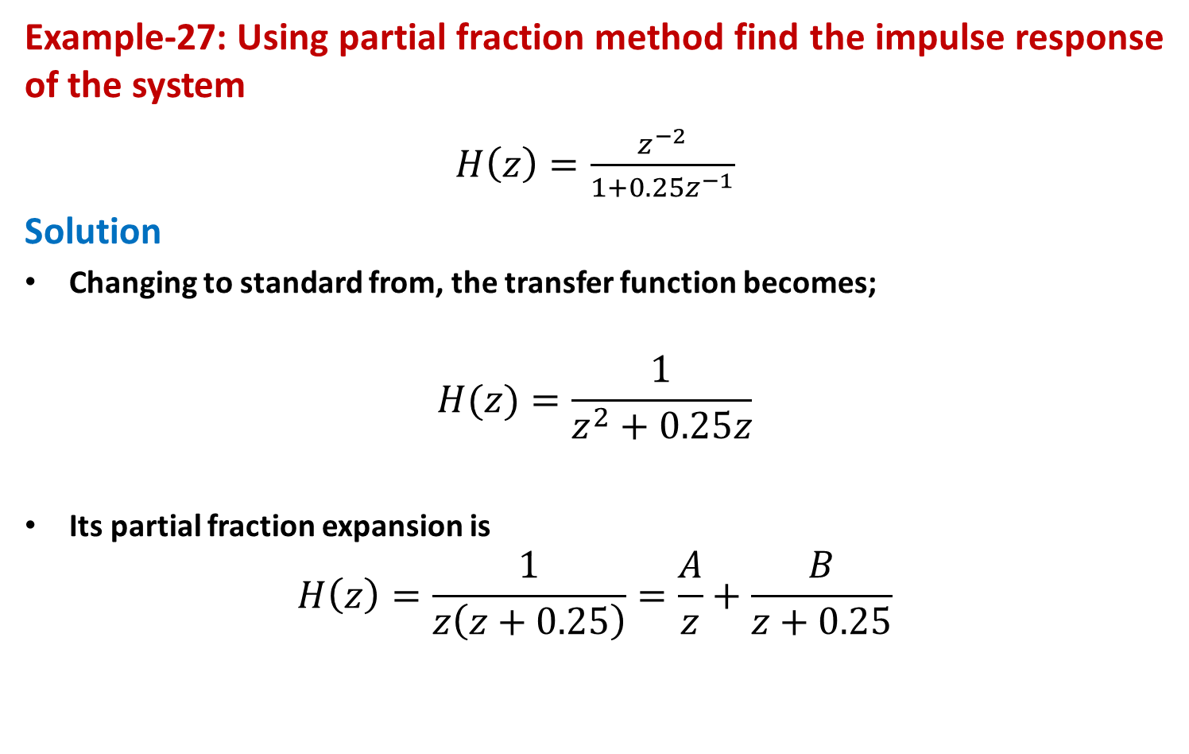
Partial Fraction Method
Example-27: Using partial fraction method find the impulse response of the system
$H\left(z\right)=\frac{z^{−2}}{1+0.25z^{−1}}$
Solution
Changing to standard from, the transfer function becomes;
$$H(z)=\frac{1}{z^{2}+0.25z}$$
Its partial fraction expansion is
$$H\left(z\right)=\frac{1}{z\left(z+0.25\right)}=\frac{A}{z}+\frac{B}{z+0.25}$$

Slide 70
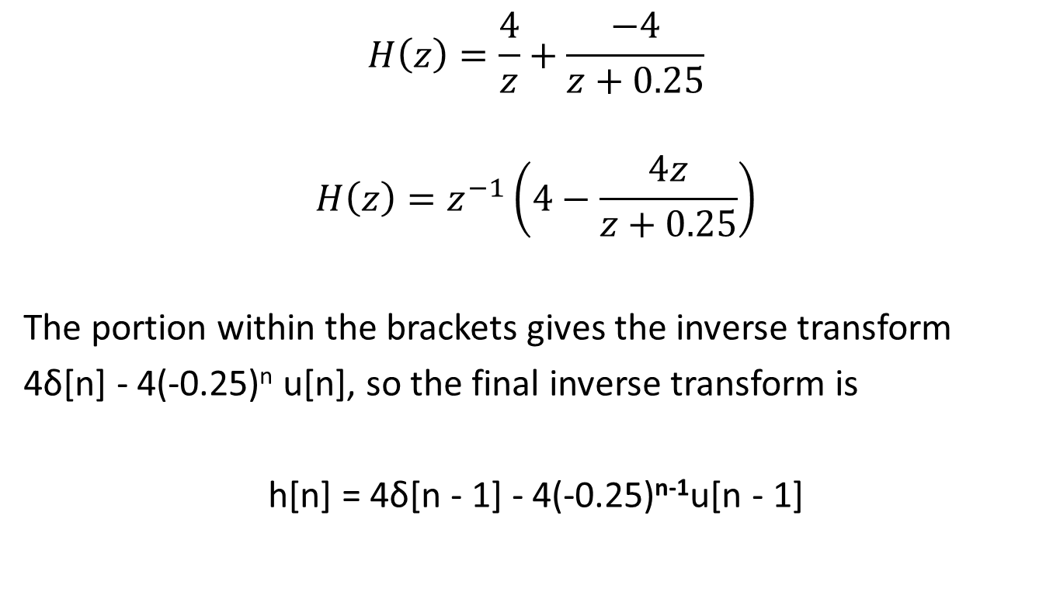
Partial Fraction Method
$$H\left(z\right)=\frac{4}{z}+\frac{−4}{z+0.25}$$
$$H\left(z\right)=z^{−1}\left(4−\frac{4z}{z+0.25}\right)$$
The portion within the brackets gives the inverse transform
4δ[n] - 4(-0.25)^{n} u[n], so the final inverse transform is
h[n] = 4δ[n - 1] - 4(-0.25)^{n-1}u[n - 1]

Slide 71
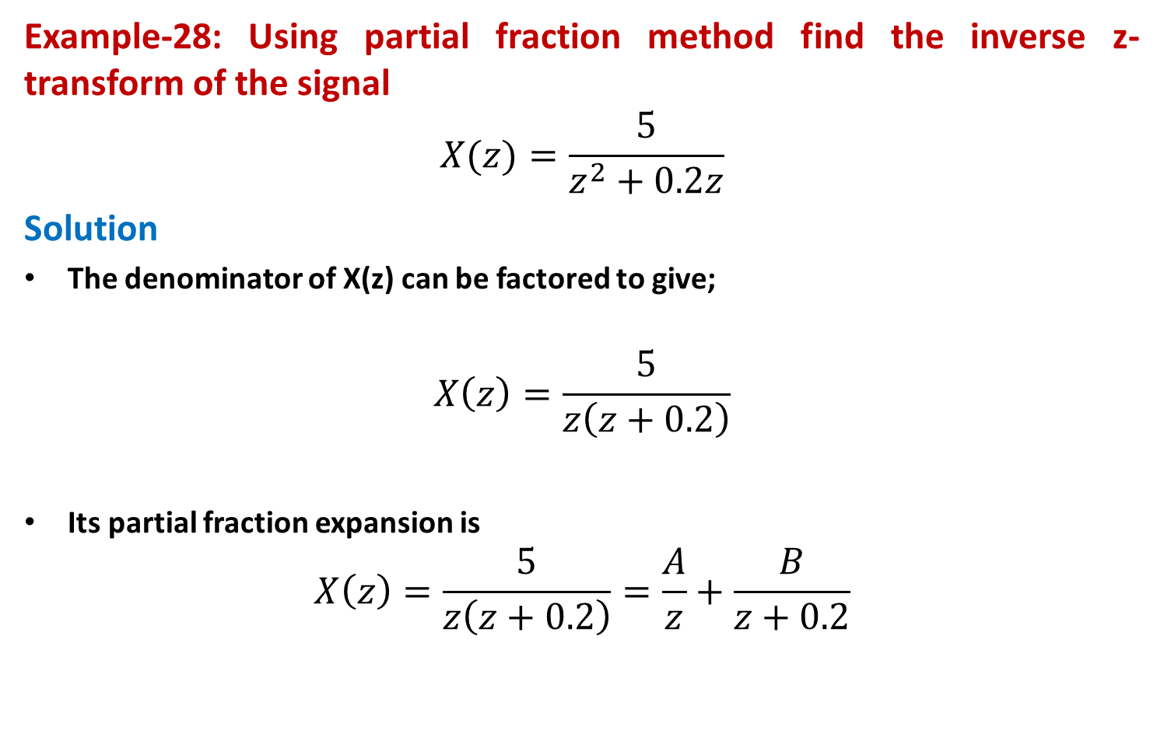
Partial Fraction Method
Example-28: Using partial fraction method find the inverse z-transform of the signal
$$X(z)=\frac{5}{z^{2}+0.2z}$$
Solution
The denominator of X(z) can be factored to give;
$$X\left(z\right)=\frac{5}{z\left(z+0.2\right)}$$
Its partial fraction expansion is
$$X\left(z\right)=\frac{5}{z\left(z+0.2\right)}=\frac{A}{z}+\frac{B}{z+0.2}$$

Slide 72

Partial Fraction Method
$$X\left(z\right)=\frac{25}{z}+\frac{−25}{z+0.2}$$
$$X\left(z\right)=z^{−1}\left(25−\frac{25z}{z+0.2}\right)$$
The final inverse transform is
x[n] = 25δ[n - 1] - 25(-0.2)^{n-1}u[n - 1]

Slide 73
Partial Fraction Method
Example-29: Using partial fraction method find the inverse z-transform of the signal
Solution
Eliminating the negative power of 𝑧 by multiplying the numerator and denominator by 𝑧² yields
Dividing both sides by 𝑧 leads to

Slide 74
Partial Fraction Method
Again, we write
where A and B are constants found as

Slide 75
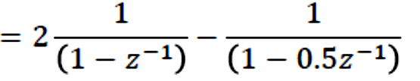
Partial Fraction Method
Thus
Multiplying 𝑧 on both sides gives
From table of z-transform pairs

Slide 76
Partial Fraction Method
Example-30: Using partial fraction method find the inverse z-transform of the signal
Solution
Dividing both sides by 𝑧 leads to
Using partial fraction method
Multiplying 𝑧 on both sides gives
From table of z-transform pairs

Slide 77
Partial Fraction Method
Example-31: Using partial fraction method find the inverse z-transform of the signal
Solution
Eliminating the negative power of 𝑧 by multiplying the numerator and denominator by 𝑧³ yields
Coefficient of highest power in denominator should be 1. Therefore

Slide 78

Partial Fraction Method
Dividing both sides by 𝑧 leads to
Using partial fraction method
Multiplying 𝑧 on both sides gives
From table of z-transform pairs

Slide 79
System Stability

Slide 80
Transfer Function & System Stability
The poles and zeros of a system can be determined easily from the system’s transfer function.
The poles and zeros of a system can provide a great deal of information about the behavior of the system.
In a standard form, TF can be expressed as a rational function consist of numerator polynomial divided by denominator polynomial.

Slide 81
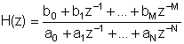
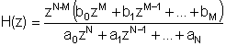
Transfer Function & System Stability
It is easiest to identify the poles and zeros if the rational transfer function
is converted to the form
which has only positive exponents.

Slide 82



Transfer Function & System Stability
The zeros or roots of the numerator polynomial are the zeros of the system.
The roots of the denominator polynomial are the poles of the system.

Slide 83
Transfer Function & System Stability

Slide 84
Transfer Function & System Stability
Poles are the values of 𝑧 that make the denominator of a transfer function zero.
Zeros are the values of 𝑧 that make the numerator of a transfer function zero.
Of the two, poles have the biggest effect on the behavior of a digital system (digital filter).
Zeros tend to modulate, to a greater or lesser degree depending on their position relative to the poles.
The poles of digital filter can be found if its transfer function is known.
Both zeros and poles are in general complex numbers.

Slide 85
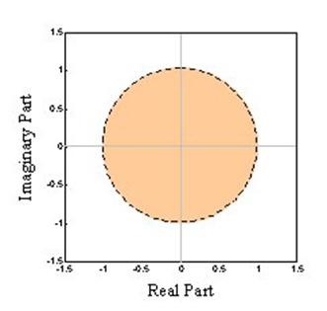
Transfer Function & System Stability
A very powerful tool for the digital system analysis and design is a complex plane called z plane, on which poles and zeros of the transfer function are plotted.
On the z plane,
poles are plotted as crosses (X)
zeros are plotted as circles (O)
A plot showing pole and zero locations is called a pole-zero plot.

Slide 86

Transfer Function & System Stability
Example-32: for a first order system the poles and zeros are
$H\left(z\right)=\frac{2}{1+0.4z^{−1}}$
Poles: at 𝑧 = -0.4
Zeros: at 𝑧 = 0

Slide 87
Transfer Function & System Stability
The position of the poles and zeros on the z plane can give clue about the way a digital filter will behave.
One reason the poles of a system are so useful is that they determine whether or not the filter is stable.
The system is stable as long as the poles lie inside the unit circle, which is a circle of unit radius on the z plane.
Since poles are complex numbers, this requires that their magnitudes be less than one.
Mathematically, the region of stability can be described as

Slide 88
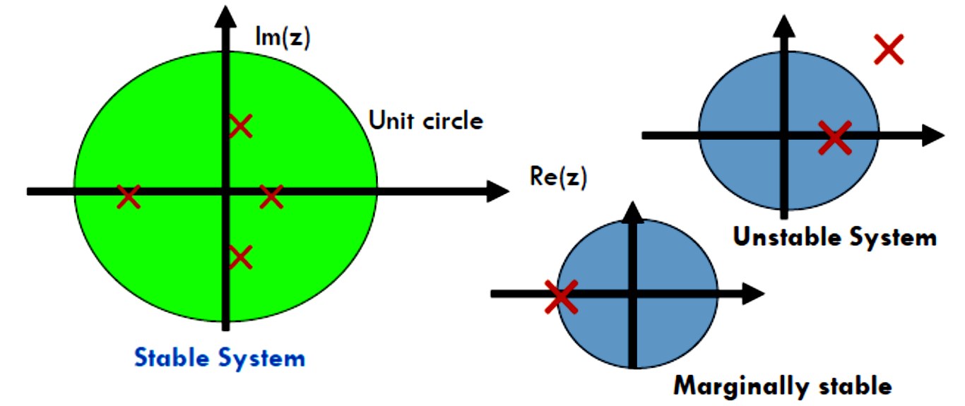
Transfer Function & System Stability
If the magnitude of each pole is less than one, the poles are less than one unit’s distance from the center of the unit circle, and the filter is stable.
If any of the poles of a system lie outside the unit circle, the filter is unstable.
If the outermost pole lies on the unit circle, the filter is described as being marginally stable.

Slide 89
Transfer Function & System Stability
Example-33: Find the poles and zeros and stability for the digital filter whose transfer function is
Solution
Eliminating negative exponents yields
Poles: at 𝑧 = 0.25 and 𝑧 = 2
Zeros: at 𝑧 = 0
As one pole lie outside the unit circle at z = 2, hence the system is unstable.

Slide 90
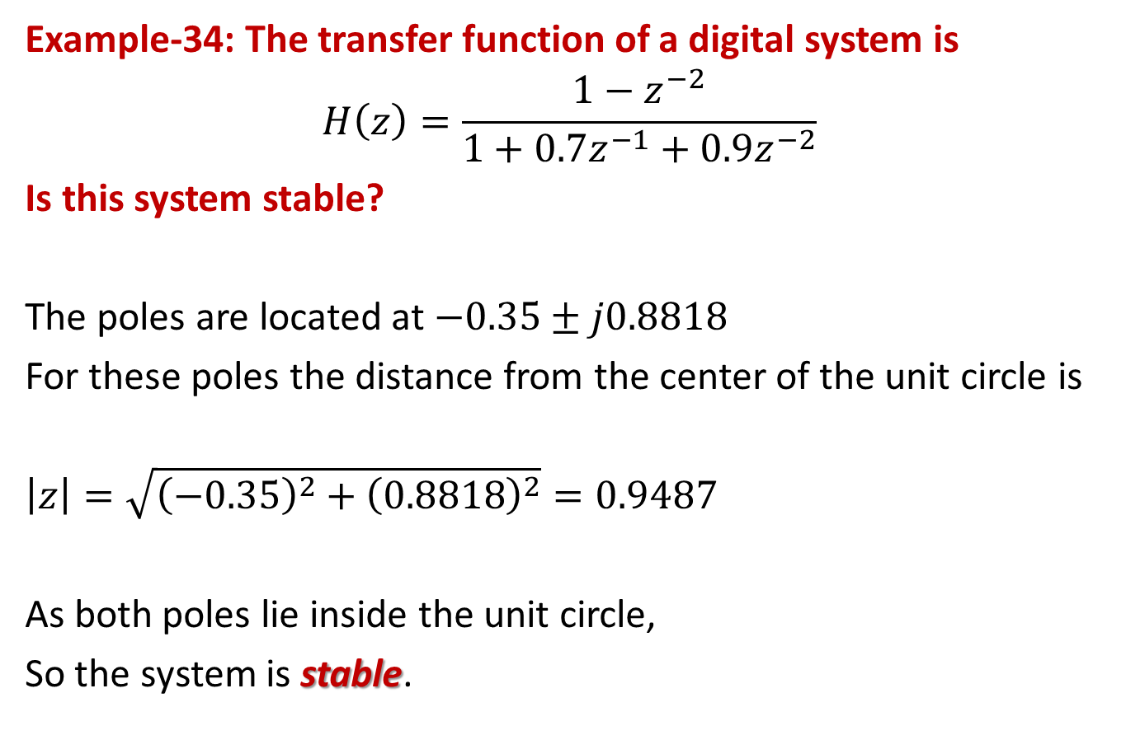
Transfer Function & System Stability
Example-34: The transfer function of a digital system is
$$H\left(z\right)=\frac{1−z^{−2}}{1+0.7z^{−1}+0.9z^{−2}}$$
Is this system stable?
The poles are located at $−0.35±j0.8818$
For these poles the distance from the center of the unit circle is
$$\left|z\right|=\sqrt{{\left(−0.35\right)}^{2}+{\left(0.8818\right)}^{2}}=0.9487$$
As both poles lie inside the unit circle,
So the system is stable.

Slide 91
Transfer Function & System Stability
Example-35: Determine the stability of the following system.
Solution: Eliminating negative exponents yields
As all poles lie inside the unit circle,
hence the system is stable.

Slide 92
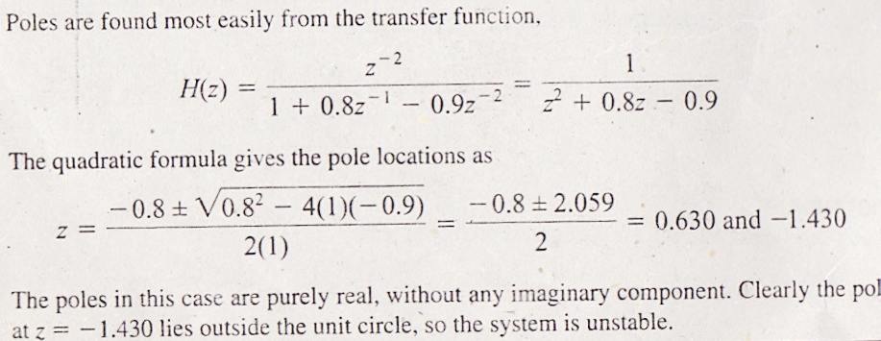
Difference Equation & System Stability
Example-36: Find the stability of the filter if the difference equation of the filter is
Y[n] + 0.8y[n-1] – 0.9y[n-2] = x[n-2]
Solution:

Slide 93
Impulse & Step Responses

Slide 94
Impulse & Step Responses

Slide 95
Impulse & Step Responses
For a step input, we can determine step response assuming zero initial conditions. Letting
the step response can be found as

Slide 96
Impulse & Step Responses
The z-transform of the general system response is given by
We can determine the output 𝑦(𝑛) in time domain as

Slide 97

Impulse & Step Responses
Example-37: The transfer function of a digital system is
Determine the difference equation of the system.
Find the pole-zero plot and evaluate stability.
Find and plot the impulse response.
Solution
a) The difference equation is
y[n] – 0.4y[n – 1] = 2x[n]
$$H\left(z\right)=\frac{2}{1−0.4z^{−1}}$$

Slide 98
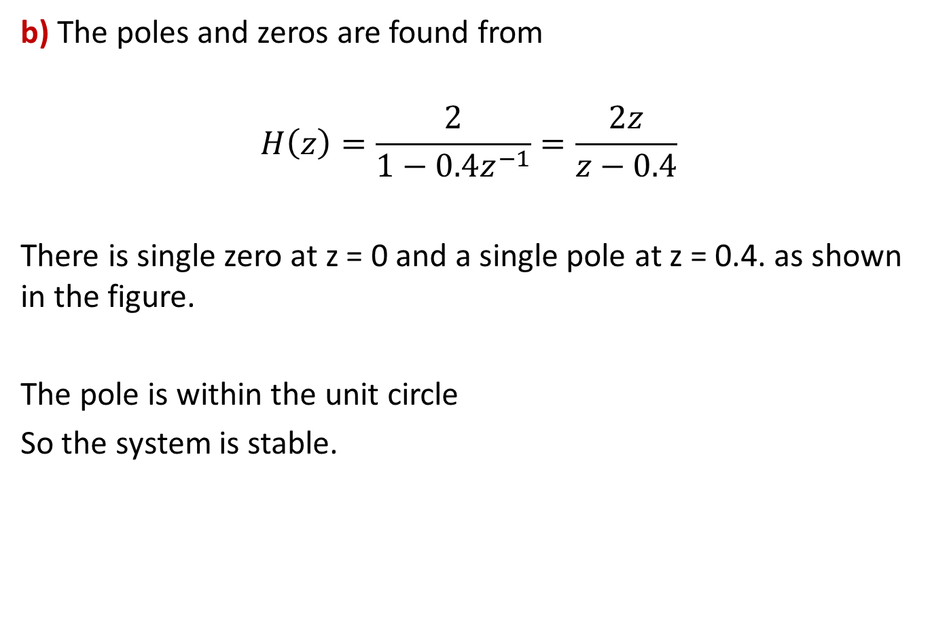
Impulse & Step Responses
b) The poles and zeros are found from
$$H\left(z\right)=\frac{2}{1−0.4z^{−1}}=\frac{2z}{z−0.4}$$
There is single zero at z = 0 and a single pole at z = 0.4. as shown in the figure.
The pole is within the unit circle
So the system is stable.

Slide 99
Impulse & Step Responses
c) The impulse response of the system is
h[n] = 2(0.4)^{n}u[n]
The impulse response is plotted in the figure.

Slide 100
Impulse & Step Responses
Example-38: Given a transfer function depicting a DSP system
Determine
the Impulse response ℎ(𝑛)
the step response 𝑦(𝑛)
system response 𝑦(𝑛) if the input is given as 𝑥(𝑛) = (0.5)^{𝑛}𝑢(𝑛)

Slide 101
Impulse & Step Responses
Solution
the Impulse response ℎ(𝑛)
The transfer function can be rewritten as
We get
Taking inverse z transform yields

Slide 102
Impulse & Step Responses
b) the Step response s(n) or y(𝑛)
the z-transform of the step response is
or
We get
Taking inverse z transform yields

Slide 103
Impulse & Step Responses
c) system response 𝑦(𝑛) if the input is given as 𝑥(𝑛) = (0.5)^{𝑛}𝑢(𝑛)
the z-transform of the step response is
or
We get
Taking inverse z transform yields

Slide 104
Impulse & Step Responses

Slide 105
Impulse & Step Responses
The impulse response of a stable system always settles to zero.
The step response of a stable system always settles to a constant value.
For unstable systems, on the other hand, these responses grow without bound.
Marginally stable systems produce cycling or oscillating behavior.

Slide 106
Impulse & Step Responses
Stability Illustrations

Slide 107
Impulse & Step Responses
Stability Illustrations

Slide 108
Impulse & Step Responses
Among the stable systems, the closer the poles are to the unit circle, the longer the impulse and step responses take to settle to their final values.
When all poles are extremely close to the origin of the z plane, the responses reach their final values almost immediately.

Slide 109
Impulse & Step Responses
Stable and unstable impulse responses on the z plane

Slide 110
Impulse & Step Responses
Poles Near Origin

Slide 111
Impulse & Step Responses
Poles Near Origin

Slide 112
Impulse & Step Responses
Poles Near Unit Circle

Slide 113
Impulse & Step Responses
Poles Near Unit Circle

Slide 114
Steady State Output
The steady state output for the step response of a stable system may be computed using the system’s difference equation, by replacing all outputs y with y_{SS} and all inputs x with one (1).
For example, the difference equation
y[n] + Ay[n-1] + By[n-2] = x[n]
produces
y_{SS} + Ay_{SS} + By_{SS} = 1
which gives a steady state output
y_{SS} = 1/(1+A+B)

Slide 115
Steady State Output
The steady state output for the impulse response of a stable system is always zero.
Replacing the outputs y with y_{SS} and the inputs x with zero (0)
For example, the difference equation
y[n] + Ay[n-1] + By[n-2] = x[n]
produces
y_{SS} + Ay_{SS} + By_{SS} = 0
which gives a steady state output
y_{SS} = 0

Slide 116
Steady State Output
The zeros of a system do not have as great an impact on the system’s behavior as do the poles.
In fact, when zeros occur far away from the poles, they have a negligible effect.
When a zero lies close to a pole, however, it effectively cancels the behavior due to the pole.

Slide 117
Impulse & Step Responses
Effect of Zero Position on Impulse Response

Slide 118
Impulse & Step Responses
Effect of Zero Position on Impulse Response

Slide 119
Impulse & Step Responses
Effect of Zero Position on Impulse Response

